Slide 1


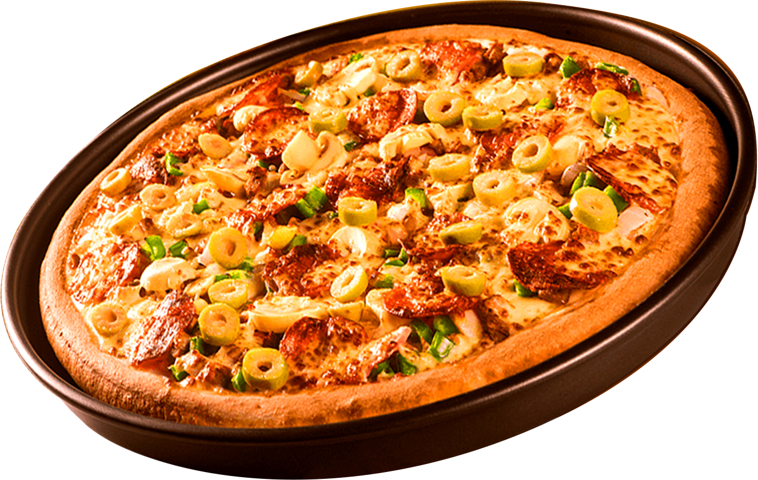
Where Every Slice is a Taste of Perfection
WELCOME TO
PIZZAHUT SALES PROJECT
By :- Anurag Nayak

Slide 2


HELLO !
Hi !!
My name is Anurag Nayak .
In this project I have utilised
SQL Queries to solve questions
regarding pizza sales.

Slide 3
DATA MODEL
CREATE TABLE pizza_type (
pizza_type_id VARCHAR(20) NOT NULL,
name VARCHAR(40) NOT NULL,
category VARCHAR(20) NOT NULL,
ingredients VARCHAR(70) NOT NULL,
PRIMARY KEY(pizza_type_id)
);
CREATE TABLE orders (
order_id INT NOT NULL,
order_date DATE NOT NULL,
order_time TIME NOT NULL,
PRIMARY KEY(order_id)
);
CREATE TABLE order_details (
order_details_id INT NOT NULL,
order_id INT NOT NULL,
pizza_id VARCHAR(20) NOT NULL,
quantity INT NOT NULL,
PRIMARY KEY(order_details_id),
FOREIGN KEY(order_id) REFERENCES orders(order_id) ON DELETE CASCADE,
FOREIGN KEY(pizza_id) REFERENCES pizzas(pizza_id) ON DELETE CASCADE
);
CREATE TABLE pizzas (
pizza_id VARCHAR(20) NOT NULL,
pizza_type_id VARCHAR(20) NOT NULL,
size CHAR(2) NOT NULL,
price DOUBLE NOT NULL,
PRIMARY KEY(pizza_id),
FOREIGN KEY(pizza_type_id) REFERENCES pizza_type(pizza_type_id) ON DELETE CASCADE
);
Data Model Structure:
orders —< order_details >— pizzas —< pizza_type
Relationships
One-to-Many between orders and order_details: Each order can
have multiple entries in order_details, with each entry representing
a unique pizza in the order.
One-to-Many between pizzas and order_details: Each pizza in the
pizzas table can appear in multiple orders (in order_details), but
each order_details entry references only one pizza.
One-to-Many between pizza_type and pizzas: Each pizza type can
be associated with multiple pizzas, but each pizza in the pizzas
table corresponds to a single pizza_type.

Slide 4
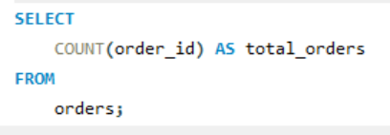
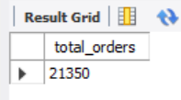
RETRIEVE THE TOTAL NUMBER OF
ORDERS PLACED.

Slide 5
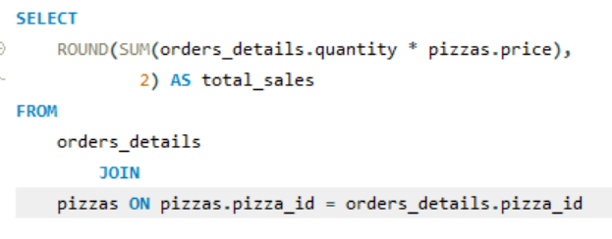

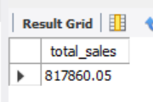
CALCULATE THE TOTAL REVENUE GENERATED FROM PIZZA SALES

Slide 6
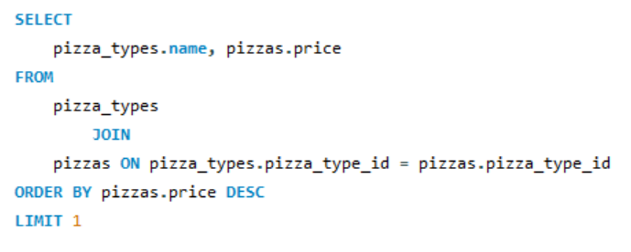
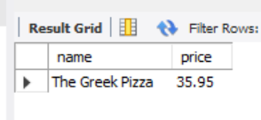
IDENTIFY THE HIGHEST-PRICED PIZZA

Slide 7
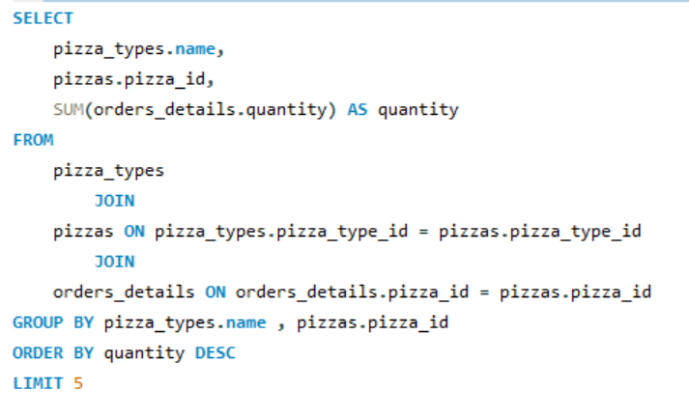
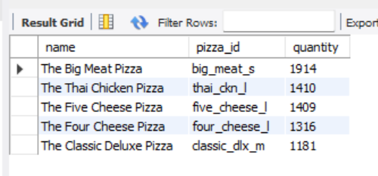
LIST THE TOP 5 MOST ORDERED PIZZA TYPES ALONG WITH THEIR QUANTITIES.

Slide 8
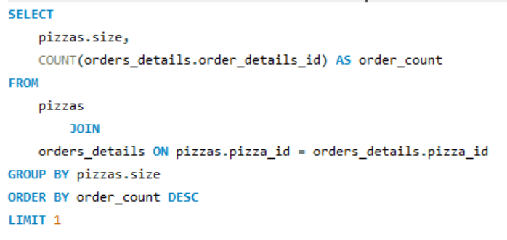

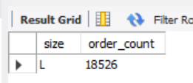
IDENTIFY THE MOST COMMON PIZZA SIZE ORDERED.
IT’S PIZZA TIME!

Slide 9
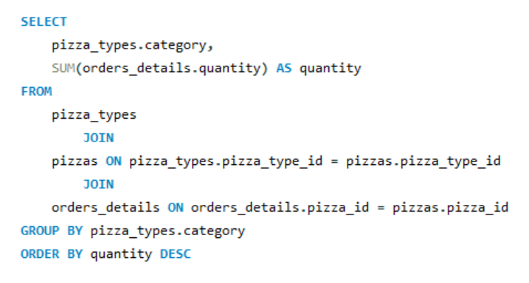
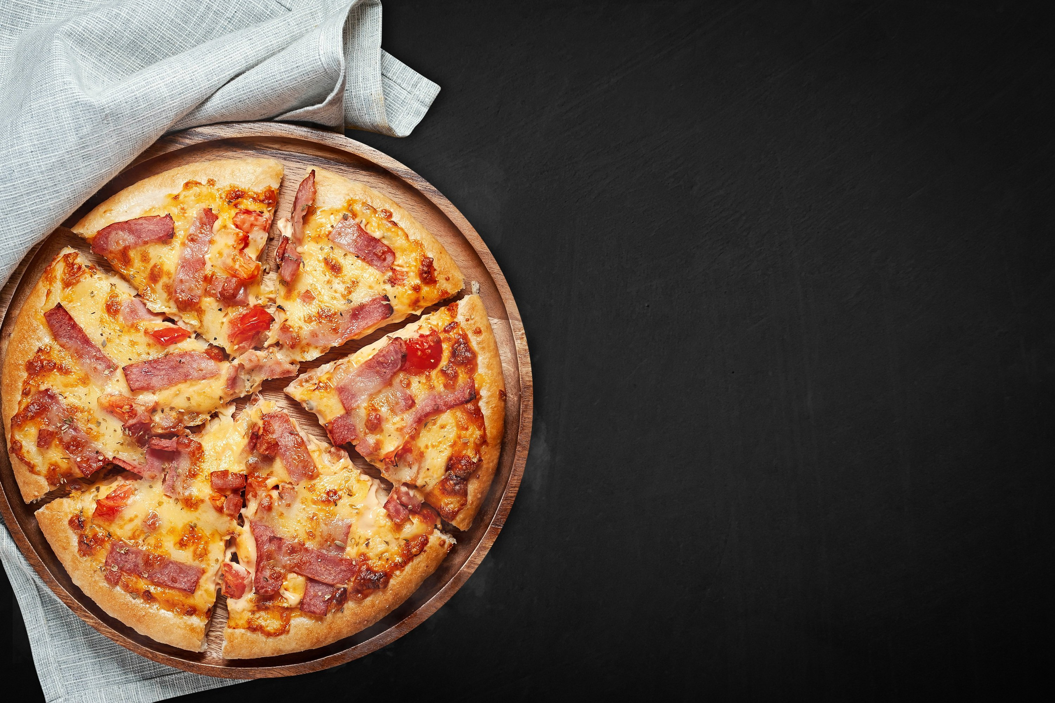
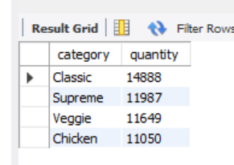
JOIN THE NECESSARY TABLES TO FIND THE TOTAL QUANTITY OF EACH PIZZA CATEGORY ORDERED.

Slide 10
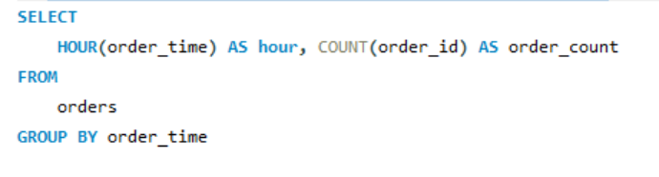
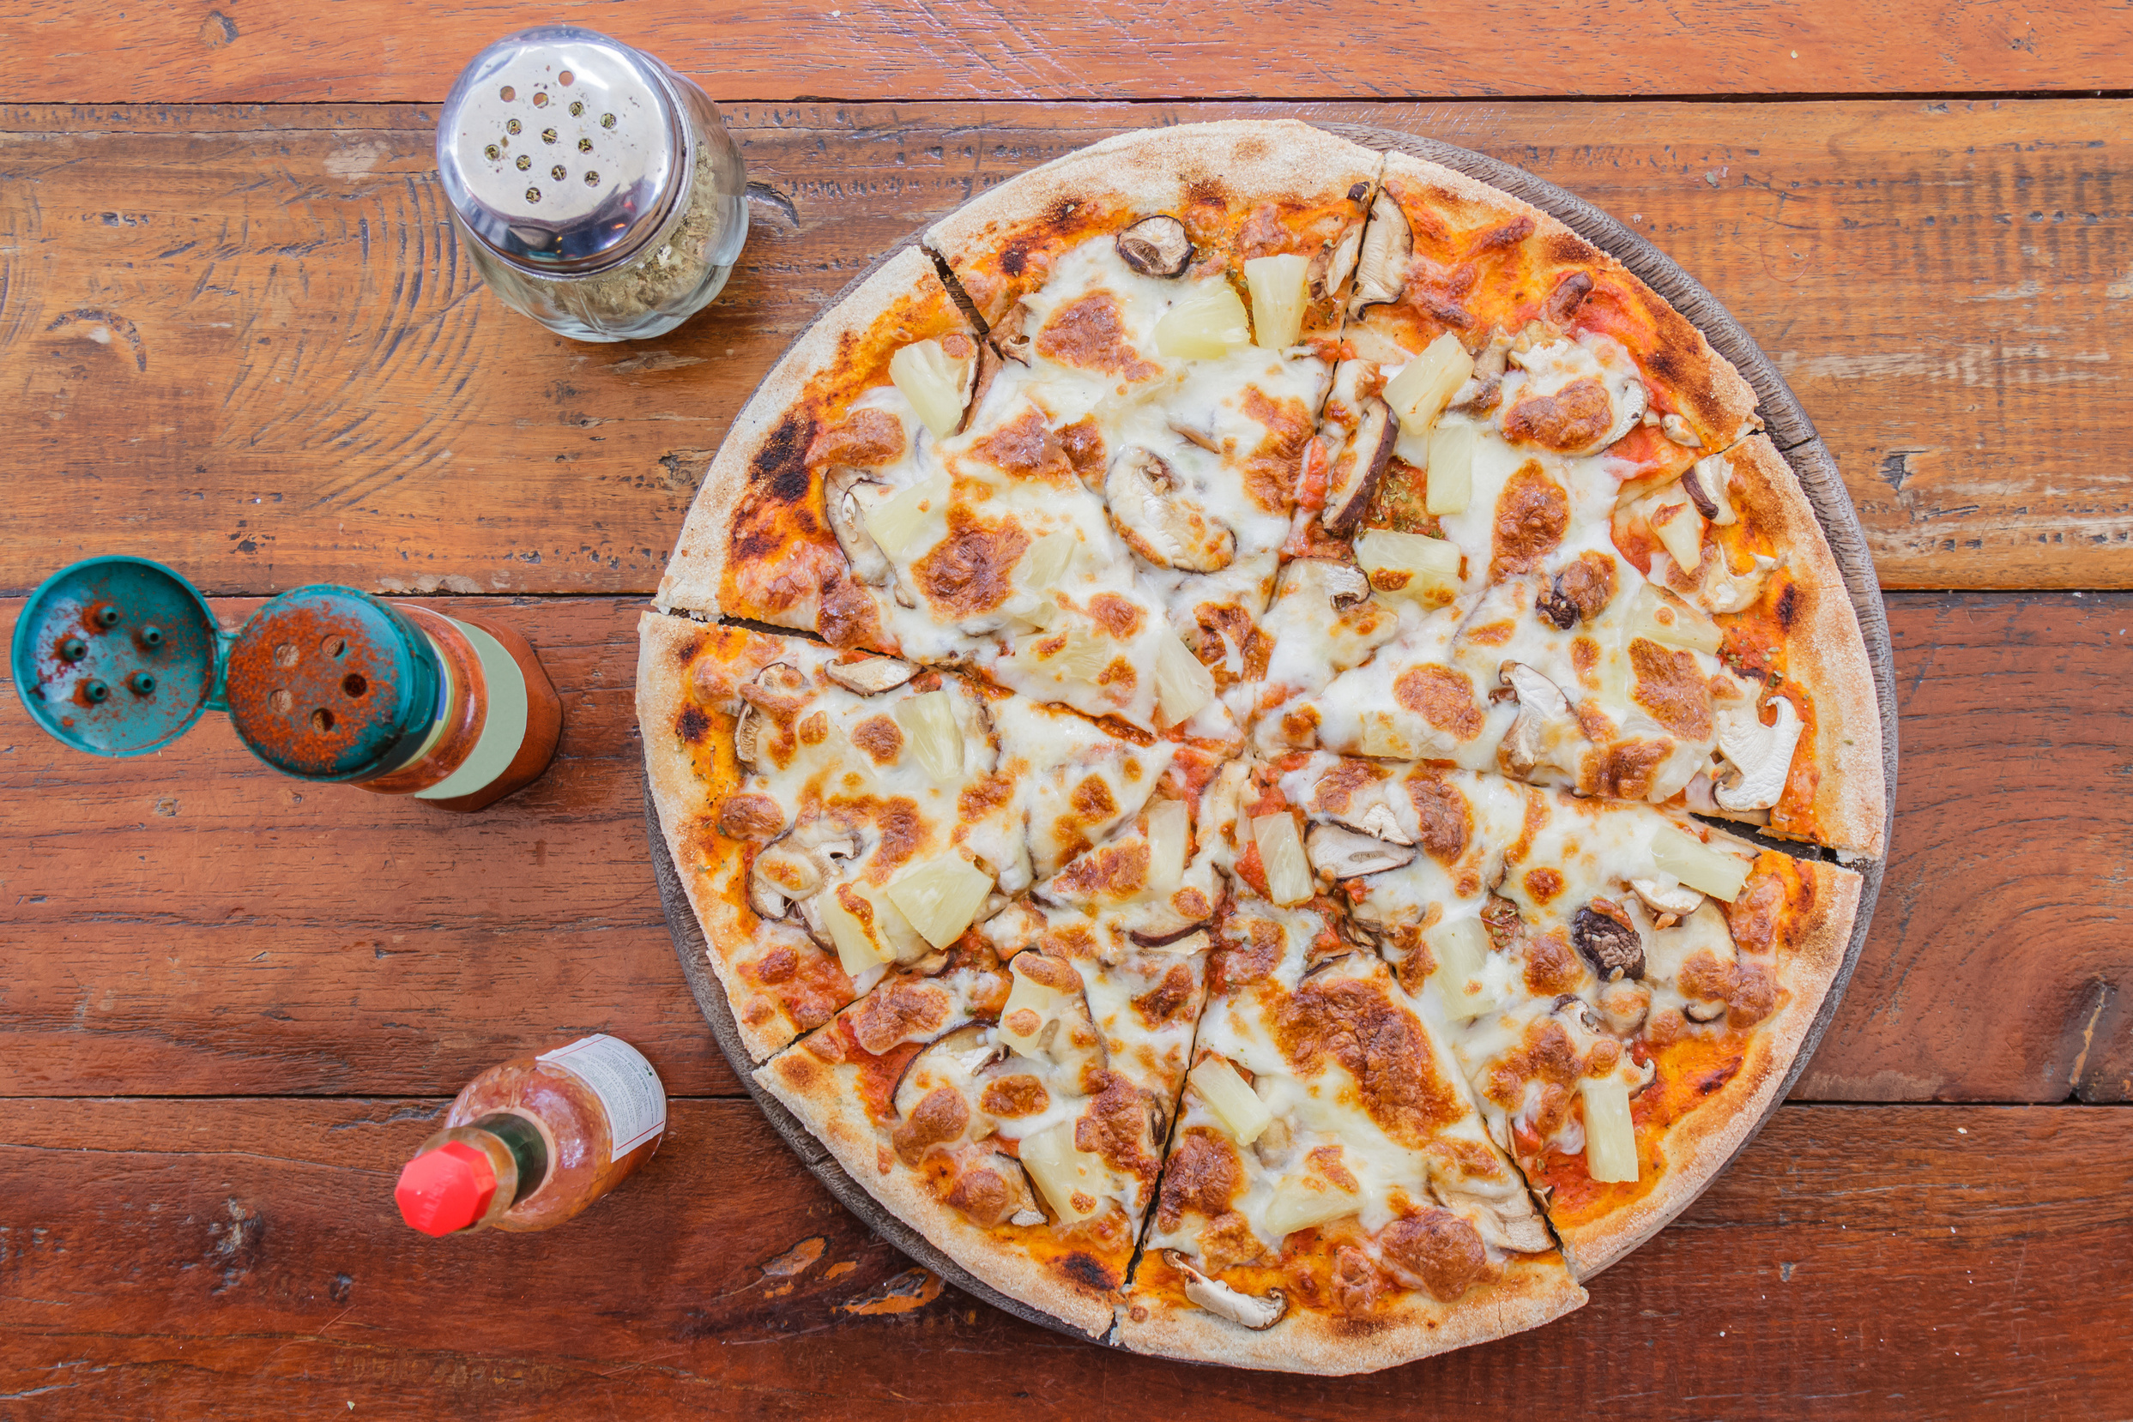
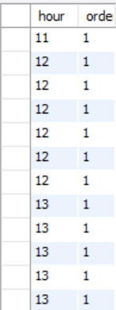
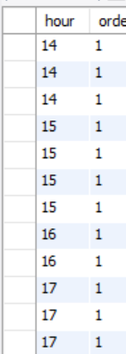
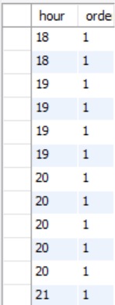
DETERMINE THE DISTRIBUTION OF ORDERS BY HOUR OF THE DAY.

Slide 11
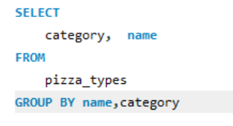
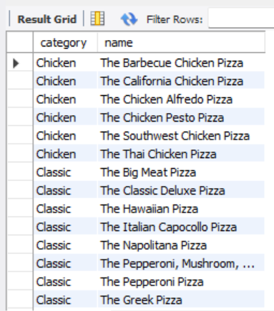
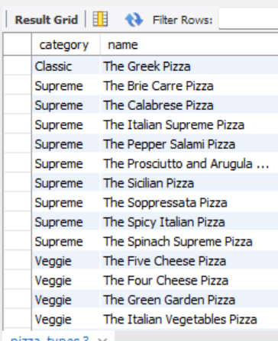
JOIN RELEVANT TABLES TO FIND THE CATEGORY-WISE DISTRIBUTION OF PIZZAS.

Slide 12
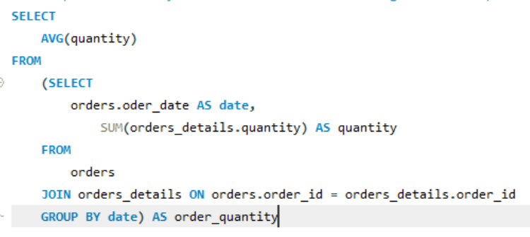
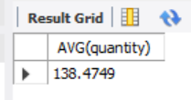
GROUP THE ORDERS BY DATE AND CALCULATE THE AVERAGE NUMBER OF PIZZAS ORDERED PER DAY.

Slide 13
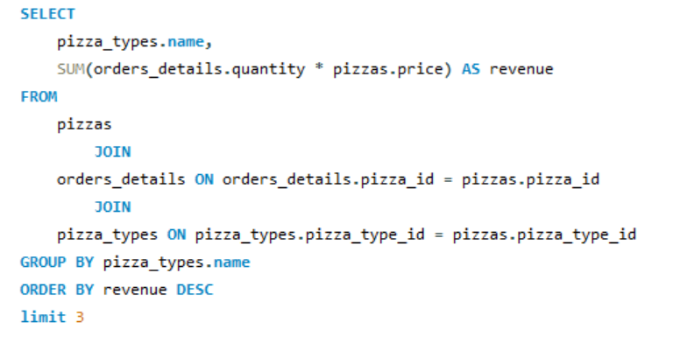
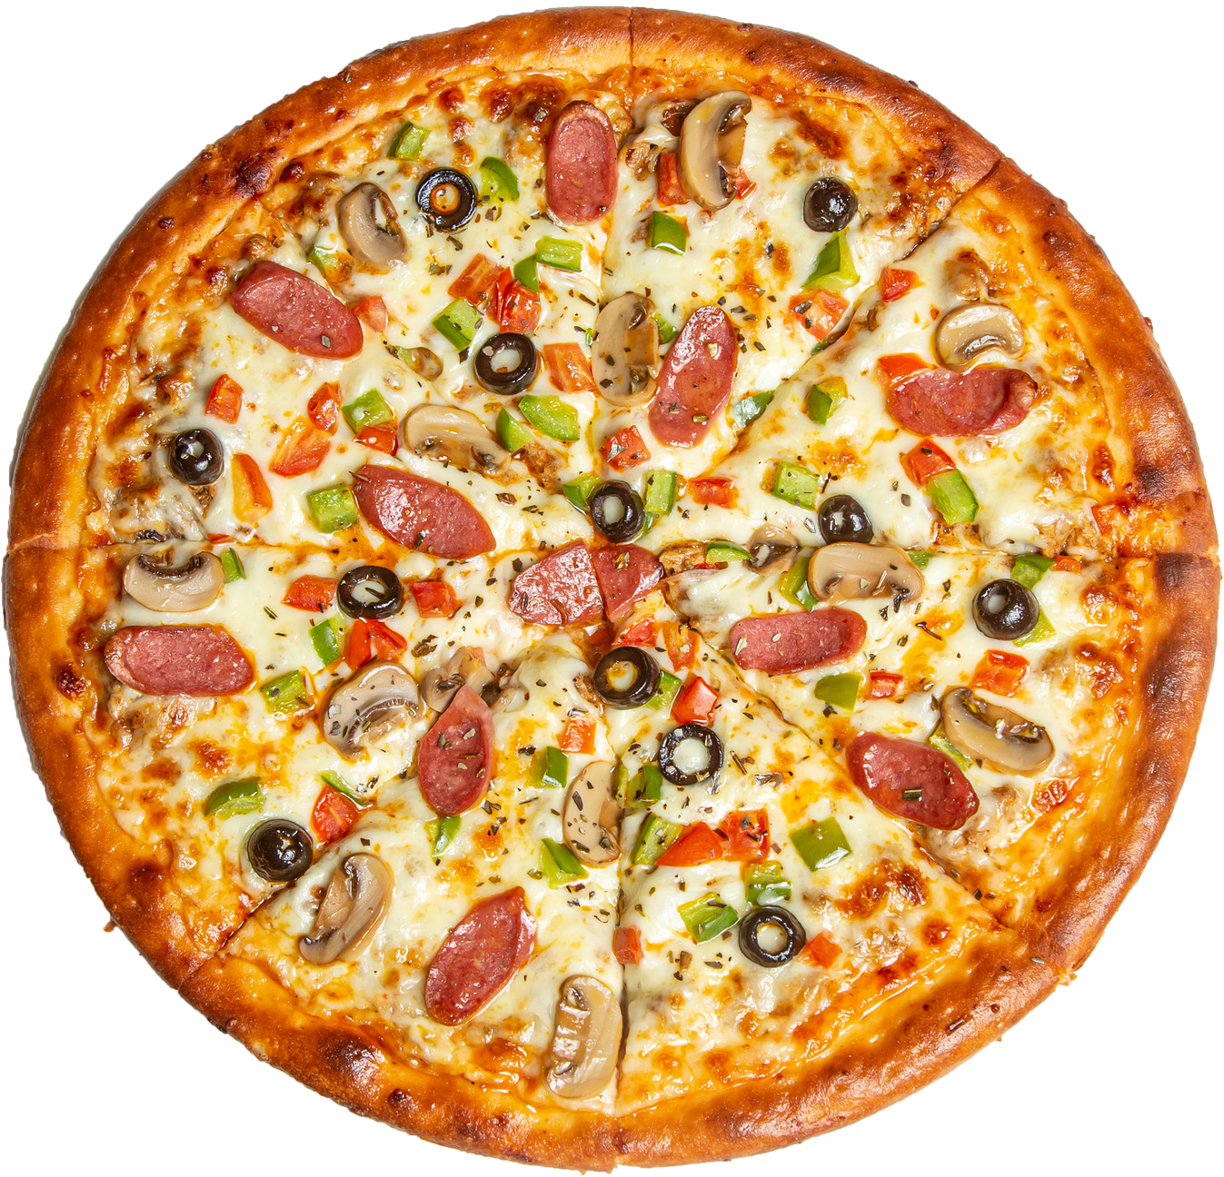
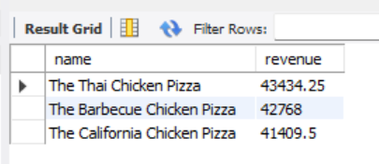
DETERMINE THE TOP 3 MOST ORDERED PIZZA TYPES BASED ON REVENUE.

Slide 14
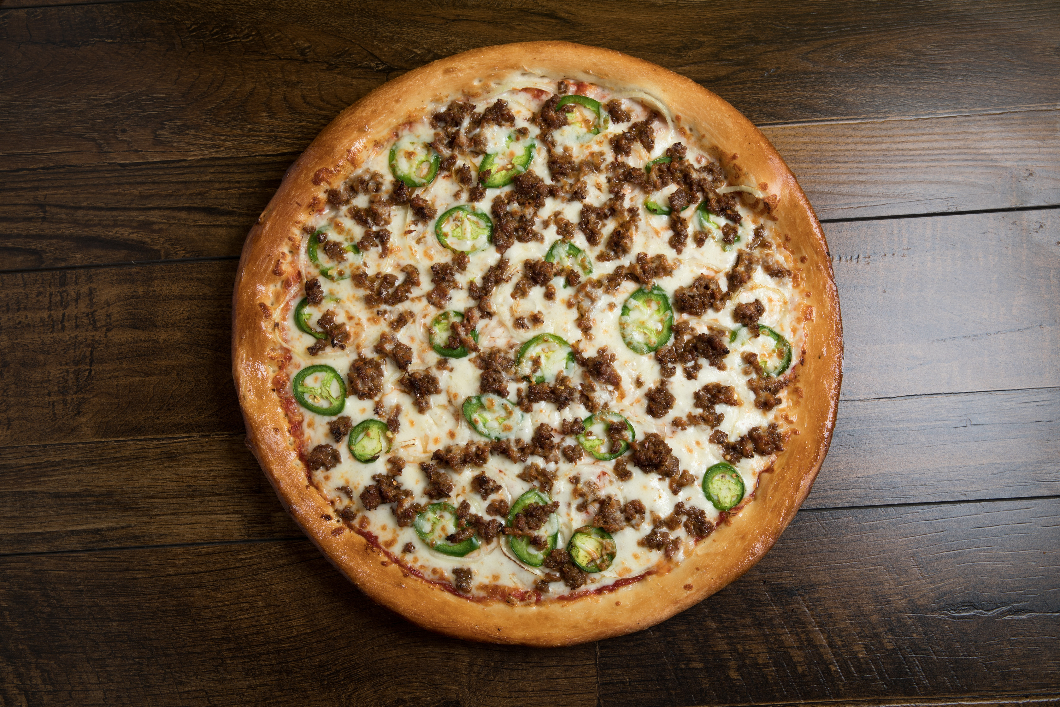
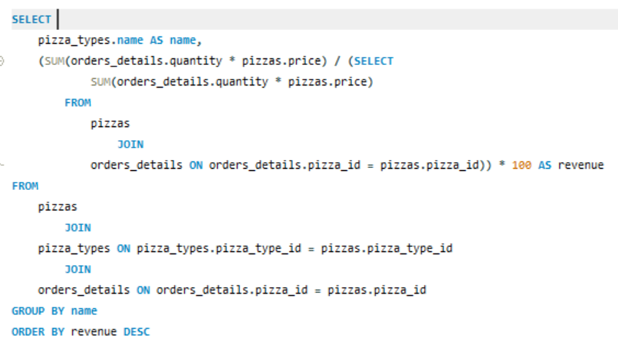
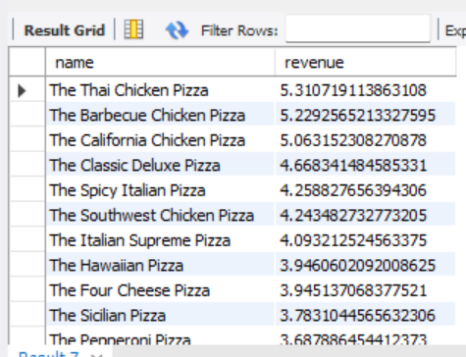
CALCULATE THE PERCENTAGE CONTRIBUTION OF EACH PIZZA TYPE TO TOTAL REVENUE.

Slide 15
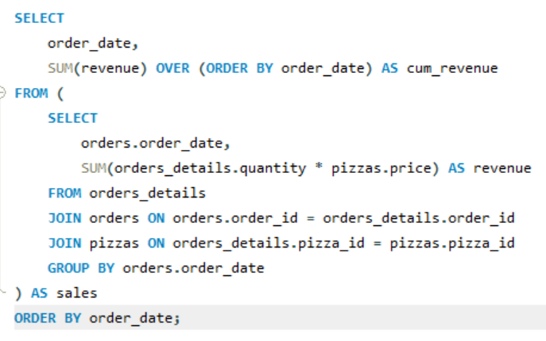
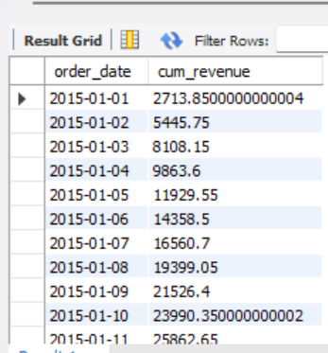
ANALYZE THE CUMULATIVE REVENUE GENERATED OVER TIME.

Slide 16
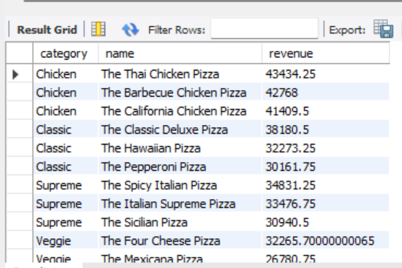
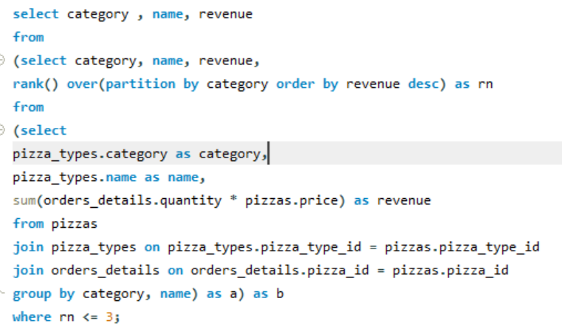
DETERMINE THE TOP 3 MOST ORDERED PIZZA TYPES BASED ON REVENUE FOR EACH PIZZA CATEGORY.

Slide 17
Pizza Resto Presentation
THANK YOU

